Slide 1
Oops Project-1 (object oriented programing) TOPIC: Sports Registrations. 2010030236 - MOHAMMED ADNAN

Slide 2

QUESTION 8 : Kartish was the head of department for sports and games in a college. He wants to create an application for students to register for the sports they’re interested in to participate without any extra paperwork. Help Kartish in making this possible by using GUI. Events included: Basketball, Volleyball, Badminton, Tennis, Table tennis. Each game can have single or double participation if available. TOPICS INVOLVED IN THIS PROJECT : 1. Packages 2. Javax.swing 3. Java.awt.event Pre-Defined Classes : ===================== jtextfield : The object of a JTextField class is a text component that allows the editing of a single line text. It inherits JTextComponent class. jframe: The javax.swing.JFrame class is a type of container which inherits the java.awt.Frame class. JFrame works like the main window where components like labels, buttons, textfields are added to create a GUI. jbutton:The JButton class is used to create a labeled button that has platform independent implementation. The application result in some action when the button is pushed. It inherits AbstractButton class Jlabel:The object of JLabel class is a component for placing text in a container. It is used to display a single line of read only text. The text can be changed by an application but a user cannot edit it directly. It inherits JComponent class.

Slide 3

what is GUI ????? The graphical user interface is a form of user interface that allows users to interact with electronic devices through graphical icons and audio indicator such as primary notation, instead of text-based user interfaces, typed command labels or text navigation. GUIs were introduced in reaction to the perceived steep learning curve of command-line interfaces which require commands to be typed on a computer keyboard. IMPORTANCE OF GUI : ========================= GUI is an interface that allows users to interact with different electronic devices using icons and other visual indicators. The graphical user interfaces were created because command line interfaces were quite complicated and it was difficult to learn all the commands in it. In today’s times, graphical user interfaces are used in many devices such as mobiles, MP3 players, gaming devices, smartphones etc.

Slide 4
OPTIONS FOR the user: ========================= JOINING A TEAM. REGISTERING IN A CLAN. CHANGING TEAM OR CLAN. PLAYING SINGLES OR DOUBLES ( IF AVAILABLE IN SPORT ). CHECK TEAM STATUS AND RANKING. LEAVING THE TEAM OR CLAN. FUTURE GAME UPDATES .

Slide 5
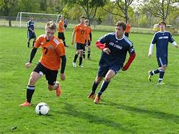
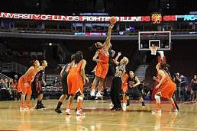


PROJECT OBJECTIVES
THE OBJECTIVE OF THIS PROJECT IS TO PROVIDE MANAGEMENT FACILITY TO SPORTS FIELD.HERE ARE SOME SERVICES ALLOTED TO USERS
It allows user multiple sports options.
User can find option to enroll for singles and doubles (if available in sport).
User friendly options .
Modify enrollments easily.

Slide 6
START
FLOW CHART
ENTER NAME
ENTER YOUR AGE
ENTER YOUR ID

Slide 7
PLAY CATEGORY
LONG GROUND SPORT
COURT GAMES
INDOOR TYPE
Basketball, Volleyball, Badminton, Tennis, Table tennis.
Cricket , hockey , foot ball .. etc .
Carrom , chess , etc..

Slide 8

Selection of singles / doubles
Print team number & details
STOP

Slide 9
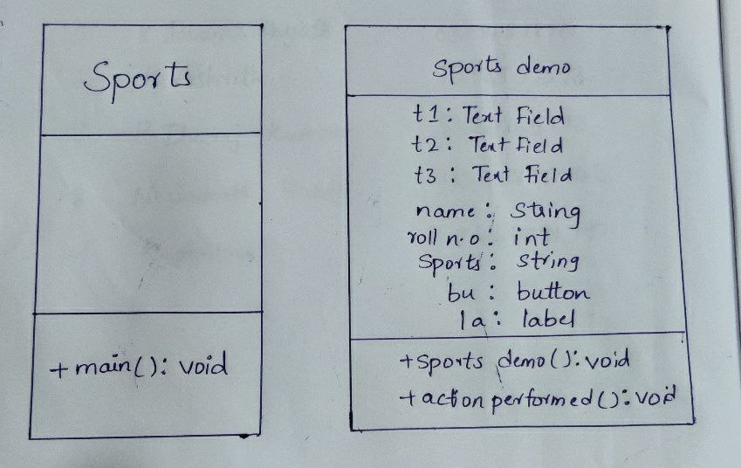
CLASS DIAGRAM

Slide 10


Slide 11
Step 1- START.
STEP 2-Enter the name.
Step 3- Enter the age.
Step 4- Enter the ID number .
Step 5-Enter the SPORTS category.
Step 6-enter the sport which player is interested in.
Step 7-Enter the mode of play singles/doubles.(if possible in sport).
Step 8-Print the team n.o and the team details.
Step 9-STOP.

Slide 12

Sample INPUT Name: enosh ID n.o : 2010030255 Sports : tabletennis Mode of play: singles Sample OUTPUT Name: enosh ID n.o : 2010030255 Sports : tabletennis Team n.o - 2 Mode of play: singles

Slide 13

THANKS FOR WATCHING This Power Point Presentation Presented by: ============ MOHAMMED ADNAN

